Slide 1
CASE STUDY
By Gonçalo Bernardo

Slide 2
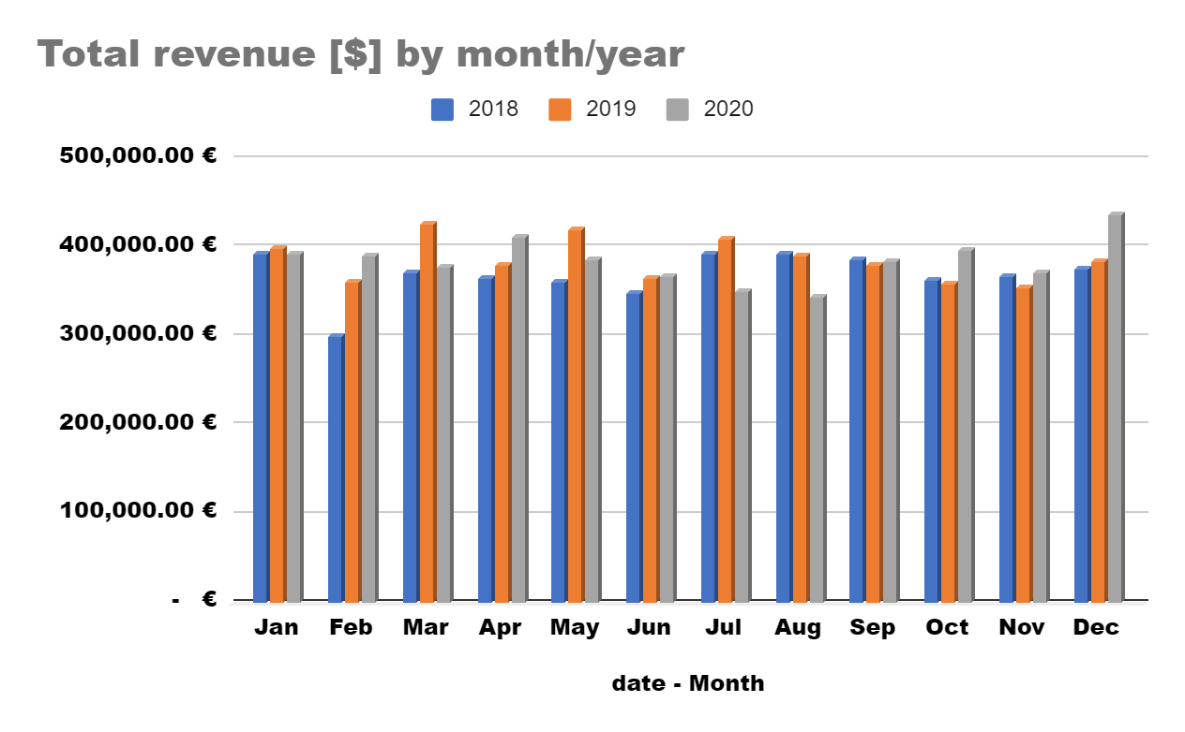
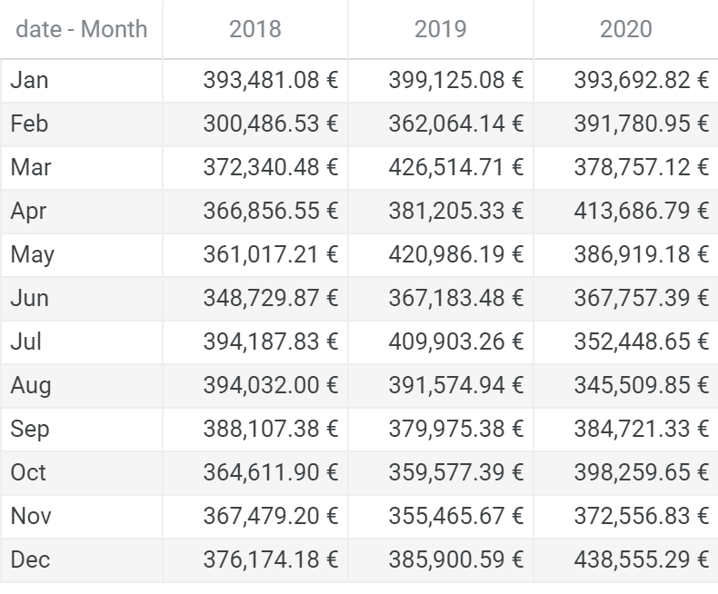
How much revenue did we make per month in 2020 compared to the previous two years?
By observing the chart and table above one can conclude that:
The revenue have been increasing along the years for 6 months of the year, having a special increasment in Febryary and the last three months of the year;
It seems that in the summer’s months, the revenue has been decreasing, in general;
The top 3 revenues occured in March and May of 2019 and December of 2020, been the last the higher (~438k €)

Slide 3
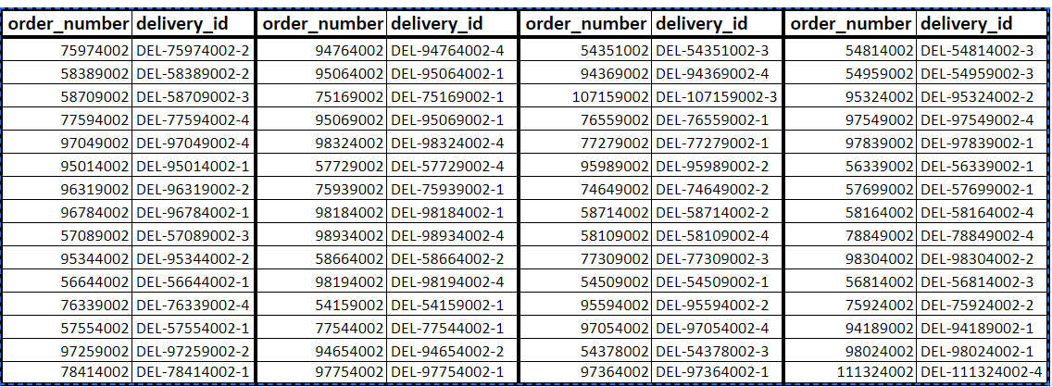
How many of our orders from 2020 have already been invoiced?
In total, 2020 has 2990 orders, having already been invoiced 135 of them.
How many products have we shipped that have not been invoiced?
We already shipped 11448 orders and 60 of them haven’t been invoiced yet.
On the right one can see the like of those 60 orders.

Slide 4
How many orders have we not yet shipped?
There are 379 orders to be shipped.
How much value of goods is not yet invoiced?
The amount of orders not yet invoiced is 439 and the total value is 712817,20€.
What was the net sales from June & August 2020 that were invoiced in the following months?
The net sales from those 2 months that were invoiced in the following months was 240834,89€.

Slide 5





eCommerce Process
Receive order
Check inventory
* Establish a minimum amount of orders for areas near the address to fill the demand of Head of logistics.
CRM
Inventory
Purchasing
Accounting
Sales
Product in stock?
Order production
Send the report to the CEO
YES
NO
Manual step
Automatic step
Payment confirmed?
Production completed?
Notify client
Update sales reports
NO
YES
Count material in stock and order to manufacturer if needed
YES
Delivered?
Shipp*
Notify client
YES

